Slide 1
Follow up of preterm babies
Naveen Jain
Senior consultant
Kerala Institute of Medical Sciences, Trivandrum

Slide 2
Minimizing disability in preterm babies
Some of the preterm babies are at risk of neurodisability
Screening of these at-risk babies and timely referral and intervention will decrease disabilities

Slide 3
Objectives of the webinar
Comprehensive care of preterm babies after discharge from the hospital
Discharge planning
Medical care
  Growth monitoring
  Recommendations on nutrition after discharge
  Recommendations on vaccination
Neurodevelopment assessment
  Recommendations on screening (for prevention of neurodevelopment disability, NDD)
  Suggested follow up schedule for development assessment

Slide 4
Discharge planning
Each unit should have place dedicated to follow up services that include all / most of the services under one roof
Dedicated personnel must coordinate the screening of at-risk babies
The unit may plan one or more days of the week dedicated to follow up

Slide 5
Discharge summary
The discharge summary must include baby’s gestation, birth weight and
risk factors for neurodevelopment – e.g
  Antenatal steroids given? / evidence of fetal growth restriction / fetal distress / chorioamnionitis
  Need for resuscitation at birth
  Need for oxygen / ventilation
  Shock
  Need for blood transfusion
  Sepsis / meningitis
  Adequacy of growth
  Hypoglycemia / jaundice …

Slide 6
Discharge planning – check list
Medical care
Weight tracking on preterm growth chart
Head circumference tracking
Nutrition advice
Immunization advice
Neurodevelopment assessment
ROP screening done / scheduled
Vision evaluation educated
Hearing screen done / scheduled
Neuro sonogram done / scheduled
KMC
Parent readiness for discharge

Slide 7
Medical care

Slide 8
Growth targets
Once preterm babies regain their birth weight (BW), expected growth targets are:
Weight – 15 to 20 g/kg per day
Head circumference – 0.5 to 1 cm /week
Length – 1 cm/week till 40 weeks

Slide 9
Preterm growth charts
Weight, length and head circumference should be measured even when baby is in NICU and continued after discharge
1-2 weekly (after discharge from hospital) for a few weeks, then at each health care visit for vaccination
The growth parameters must be plotted and growth tracked on growth charts for preterm babies (example: Fentons growth chart)

Slide 10
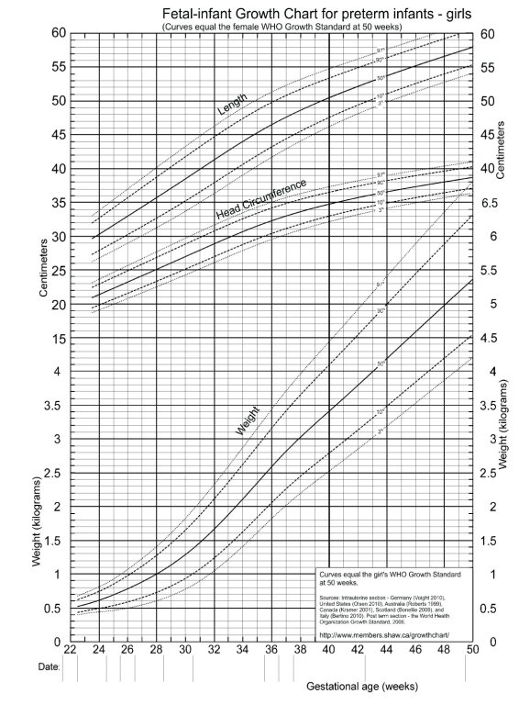
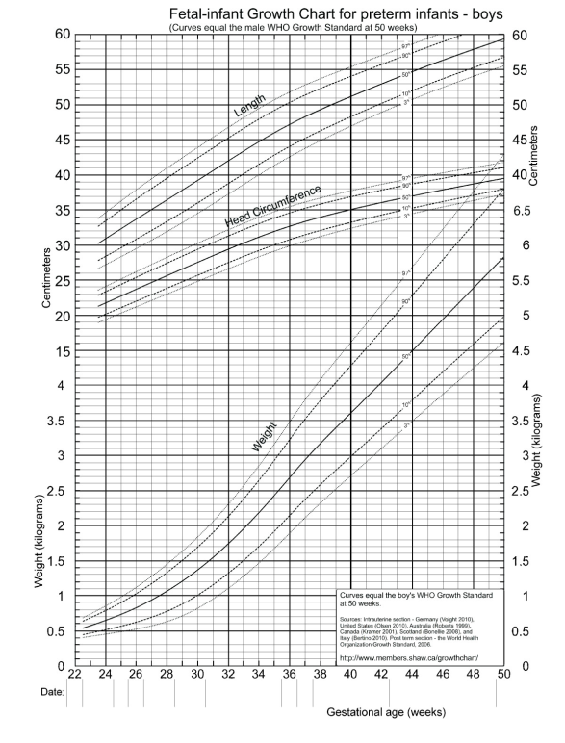
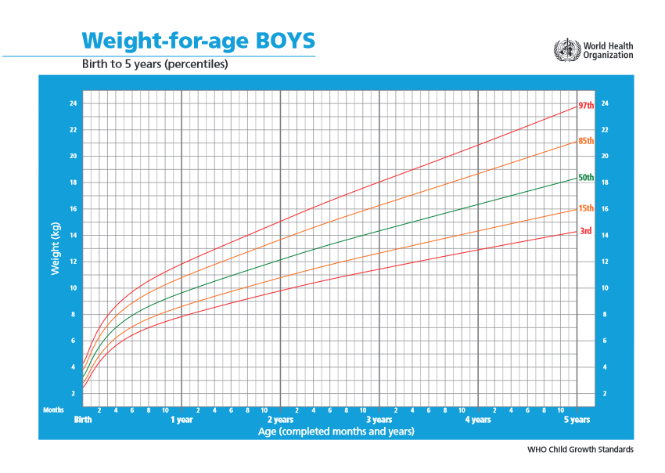
Growth charts
Fenton’s growth chart
WHO growth chart

Slide 11
Complementary feeding
Exclusive breast milk must be continued till 6 months age corrected for prematurity
Complementary feeding with semisolid foods should be started at 6 months age
There is no change in age of starting complementary feeding for preterm babies

Slide 12
Immunization – no change for preterm babies
The immunization schedule remains unchanged for preterm babies (chronological age: counted from the date the baby was born)
“Medically stable PT and low birth weight (LBW) infants should receive full doses of diphtheria, tetanus, acellular pertussis, Haemophilus influenzae type b, hepatitis B, poliovirus, and pneumococcal conjugate vaccines at a chronologic age consistent with the schedule recommended for full-term infants”

Slide 13
Birth doses of BCG / Hep B and OPV at discharge
The birth doses of BCG, OPV may be given once the preterm baby is medically stable and ready for discharge (at or after 34 weeks gestation)
If preterm baby is < 2kg, one may give Hep B once the baby is 30 days old / ready for discharge (mother is Hep B negative or immunized)

Slide 14
Neurodevelopment assessment

Slide 15
Education of parents on follow up
Parents should be educated regarding
  The need to test
  Follow up schedules
  Possible interventions if a deviation from normal is detected

Slide 16
Screening of preterm babies – to prevent NDD
  ROP screening
  Vision assessment at 9-12 months
  Hearing screening and diagnostic tests before 6 months age
  Multi-domain development tests at 4, 8, 12 months
  Neurosonogram at 1-2 weeks and 36- 40 weeks

Slide 17
ROP screening
Often the preterm babies are discharged before the ROP screening is complete
The families must be educated on the need to follow up till ophthalmologist informs that screening is complete / treatment of ROP is required

Slide 18
Eye check at 9- 12 mo
Preterm babies are at increased risk of strabismus, myopia and late retinal detachment
They should undergo examination by an ophthalmologist at 9 to 12 months of age

Slide 19
Hearing screen
Preterm sick babies are at increased risk for sensorineural hearing loss, so automated auditory brainstem response (AABR) should be done
It is best to complete AABR before discharge from hospital at birth admission
  Otoacoustic emissions (OAE) will fail to detect sensorineural hearing loss
In baby fails screening tests, confirmation of hearing loss and intervention must be initiated before 6 months age

Slide 20
Neurodevelopment assessment
Assess neurologic abnormalities (tone)
Do multi-domain development screening including motor, cognition, hearing and vision, and language (e.g. CDC grade, Denver II, Bayley screener)
Time: 4 , 8 and 12 months age corrected for prematurity
Recognize, refer for early intervention

Slide 21
Opportunity to reduce disability
Appropriate follow up is an opportunity to detect early and correct deviations in development
Neonatologist must explain to parents the tests and the treatments
Visits to the specialists may be facilitate by dedicated staff
  They are involved in parent education, managing appointments and guiding parents to intervention programs.

Slide 22
Intact outcomes
The goal to save preterm babies without disability can be achieved by timely screening and appropriate interventions

Slide 23
Follow up checklist: what to do and when?
S No. | Area | Frequency | Details
A | Anthropometry | Every Visit | HC, weight at every visit, length at every 3 months
B | Breastfeeding | Every Visit | Observe the breastfeeding session if possible
C | Counseling | Every Visit | Feeding , hygiene, KMC, Innocuous issues Ask mother about her concerns
D | Development Screening | 4, 8, 12 months | CDC grading/ Denver II/ Bayley screen Fill up the chart and refer where needed for detailed developmental evaluation
E | Eye | After initial ROP evaluation, detailed examination at 9-12 months of age | Emphasize on getting a ROP screening from a skilled ophthalmologist
F | Neuro sonogram | 1-2 weeks and 36- 40 weeks | To rule out PVL and other abnormalities
G | Growth Monitoring | Every visit | Plot the growth of the baby on the WHO growth charts
H | Hearing | Ideal before discharge , complete diagnosis by 6 months | AABR is preferred
I | Immunizations | As per schedule | BCG, Hep B and OPV at discharge
O | Others | Language/speech at 1,2,3 years Behavior at/after 1 year IQ testing at 3 years of age. | Any delay detected should prompt early intervention

